Slide 1

Investor Pitch
Deck Template
Vitaliy Schafer & Vivek Udaykumar

Slide 2
Your Logo Here
Name
vision
Notes:
Vision:
Summarize the long-term goal or mission of your startup in 4-6 words.

Slide 3
problem
State the problem that you solve for your target customers.
Notes:
“Problems” can also appear as unmet needs or wants — the lack of a good Caribbean restaurant in your town, for example.
Tips:
Provide context and background information with numbers to help investors understand the significance of the problem within the market or industry.
Use data and statistics to quantify the scope and impact of the problem.
Highlight relevant market research, surveys, or industry reports that support your claims.
Share real-life examples, anecdotes, or customer stories to illustrate the pain points experienced by your target audience.
Use empathy to connect with investors and convey the emotional aspects of the problem.
Discuss any relevant market trends or shifts that exacerbate the problem or create new opportunities for your solution.
Demonstrate an understanding of the broader market dynamics and how they influence the problem your company is addressing.
Avoid overwhelming your audience with too much information.
Remember that the goal is to capture investors' attention and convince them of the urgency and significance of the problem you're solving.

Slide 4
our solution
Explain how your solution works.
What does your company offer?
What is it about your solution that provides a uniquely effective remedy for their pain points?
Notes:
Don’t just name your products or services here. Give a sense of how they solve the problem in a novel or superior way.
Explain how your product or service improves their lives, saves them time, money, or effort, or helps them achieve their goals more effectively.
Highlight what makes your solution unique and superior to competing products or services.
Discuss any proprietary technology, intellectual property, or innovations that give you a competitive edge.
Use visuals, diagrams, or demonstrations to illustrate how your solution works.
If your solution is technology-based, briefly discuss the underlying technology stack or architecture.
Share any evidence or validation that demonstrates the effectiveness of your solution.
This could include pilot programs, beta testing results, customer testimonials, or early traction metrics.
Focus on conveying the core essence of your solution in a clear and straightforward manner.

Slide 5
our product
or service
Detailed Explanation of Product or Service
Notes:
Start by clearly describing what your product or service is.
Briefly mention the current stage of development or maturity of your product or service.
If applicable, discuss any future updates, enhancements, or expansion plans.
Validation or Traction:
Share any validation or traction you've achieved with your product or service.
This could include customer testimonials, user feedback, early sales, or partnerships.
Roadmap or Future Plans:
Provide a glimpse into the future by outlining your product roadmap or future development plans.
Highlight any upcoming features, enhancements, or milestones.
Keep it Engaging:
Use engaging visuals, storytelling, and compelling language to capture the attention of your audience.
Focus on conveying the excitement and potential of your product or service.

Slide 6
business
model
part one
Primary revenue streams
part two
Summary of your pricing strategy and profit margin
1-2 slides
Notes:
Revenue Streams:
Clearly identify the primary sources of revenue for your business.
Describe how you intend to monetize your product or service visually.
If there are multiple revenue streams, outline each one and explain how they contribute to your overall business model.
Pricing Strategy:
Explain your pricing strategy and how you arrived at your pricing model.
Discuss whether you plan to use a subscription-based model, one-time purchases, freemium, licensing, or other pricing structures.
Highlight any competitive advantages or market insights that inform your pricing strategy.
Customer Segments:
Identify the specific customer segments or target markets you are catering to.
Explain how you plan to acquire and retain customers within each segment.
Discuss any niche markets or customer segments you may be targeting initially.
Customer Acquisition Strategy:
Outline your plan for acquiring customers and growing your user base.
Discuss the marketing channels, strategies, and tactics you will utilize to reach your target audience.
Include details about customer acquisition costs (CAC) and customer lifetime value (CLV) if available.

Slide 7


target
market
What types of potential customers do you intend to focus on? Which group represents your primary market? Which others are worth pursuing?
Research to make your best guess at how many prospects are available in each segment and how much they typically spend each year to address the problem you solve.
$100M
market
size
market segments
$1M
TAM
Segment 1
SAM
Segment 2
$500K
SOM
Segment 3
Segment 4

Slide 8
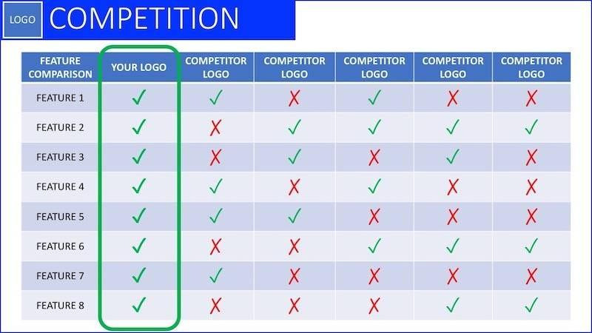
competitive landscape

Slide 9
competitive advantage
advantage one
What distinguishes you from your competitors
advantage two
Where you see your position in the market compared to your competitors
advantage three
What you have that will be difficult for competitors to get around
Notes:
Competitor Analysis:
Identify key competitors in your industry or market segment.
Provide a brief overview of each competitor, including their products or services, target market, and strengths.
Competitive Advantages:
Discuss what makes your competitors successful in the industry.
Analyze their strengths, such as brand reputation, market share, technological capabilities, distribution networks, or pricing strategies.
Points of Differentiation:
Highlight how your offering differs from competitors' products or services.
Identify your unique selling points (USPs) and competitive advantages that make your offering more attractive to customers..
Mitigating Competitive Threats:
Address how you plan to mitigate competitive threats and defend your market position.
Discuss strategies for differentiation, innovation, customer retention, or expanding into new markets.

Slide 10
Marketing plan
Sales Channels.
Marketing Activities
Notes:
How do you plan to get your products or services to market? Are you selling and delivering to your target customers directly through a retail store, website or catalog? Do you have a sales team? Do you sell through intermediaries – distributors, dealers, resellers, or others?
How do you plan to attract attention, build interest in your offerings, and convert prospects into customers? What sort of online marketing do you do? Do you advertise? Where? Do you attend trade shows or sponsor events? Is your marketing through partners like resellers or dealers?

Slide 11
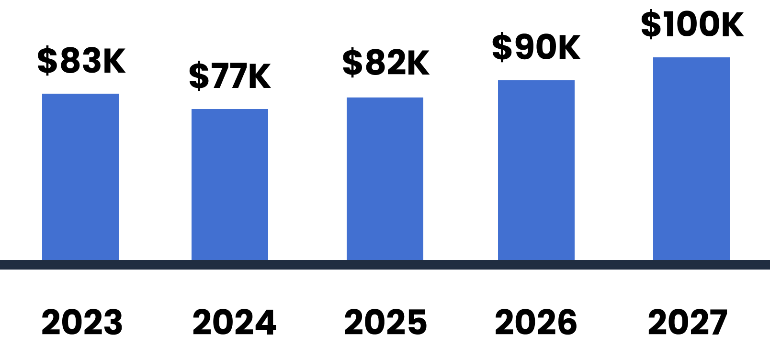
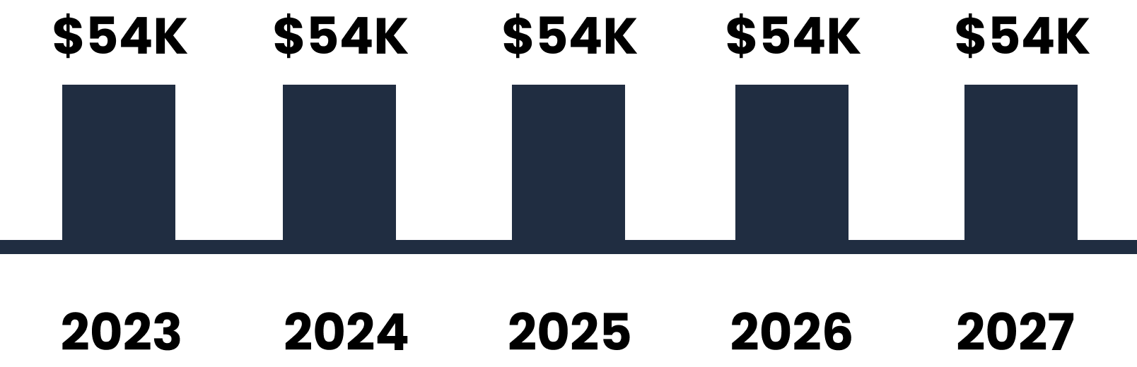
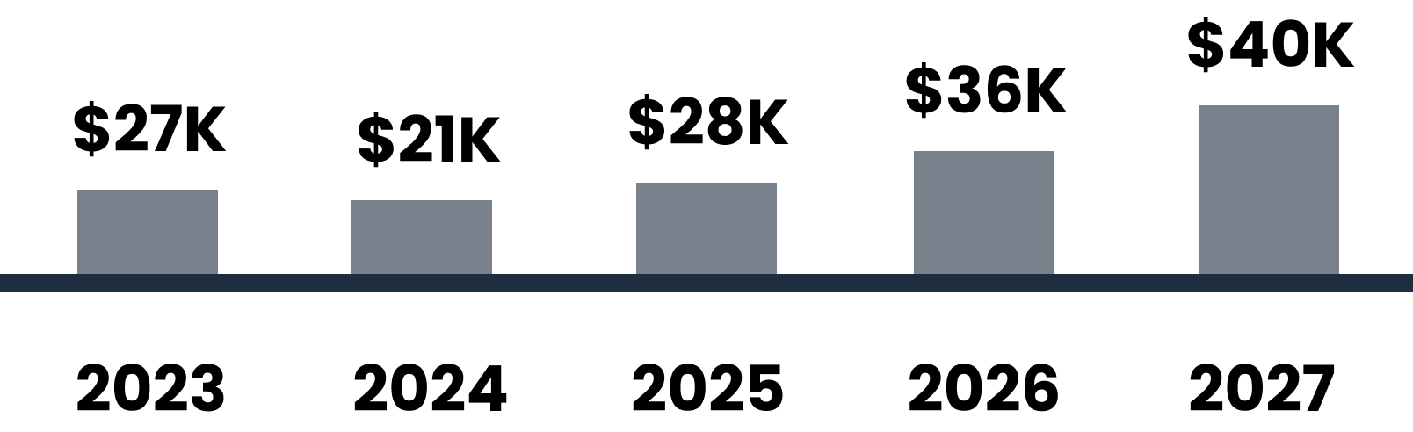
financial
projections
revenue
expenses & costs
profit
Financial Modeling Proforma
Notes:
Revenue Projections:
Outline your projected revenue streams over the next few years.
Break down revenue projections by product/service categories if applicable.
Cost Structure:
Detail your anticipated operating expenses, including fixed costs (e.g., rent, salaries, utilities) and variable costs (e.g., cost of goods sold, marketing expenses).
Gross Margin and Profitability:
Project your company's profitability over time, considering both gross profit and net profit after accounting for operating expenses.
Cash Flow Projections:
Provide a cash flow forecast that outlines your expected cash inflows and outflows.
Break-Even Analysis:
Conduct a break-even analysis to determine the point at which your company's total revenue equals total costs.
Identify the number of units or customers you need to sell to break even and achieve profitability.
Investment Requirements:
Specify your funding requirements to achieve your financial projections.
Detail how much capital you need to raise and how you plan to allocate it across different areas of your business.
Financial Model:

Slide 12
milestones
Date
Date
Date
Date
A significant goal your company has achieved.
Traction you’ve made so far.
Notes:
Strategic Milestones:
Identify the most critical milestones in your company's development.
These could include product development milestones, regulatory approvals, market launch dates, key partnerships, or revenue targets.
Timeline:
Present a timeline that shows when each milestone is expected to be achieved.
Use visual aids such as Gantt charts or timelines to illustrate the sequencing and dependencies of milestones.
Current Status:
Provide an overview of your current progress towards achieving each milestone.
Highlight any milestones you've already achieved to demonstrate traction and momentum.
Future Milestones:
Outline upcoming milestones that are essential for your company's growth and success.
Discuss how achieving these milestones will drive value creation and de-risk the investment opportunity.
Key Performance Indicators (KPIs):
Define the key performance indicators (KPIs) that you're using to track progress towards each milestone.
Explain how you're measuring success and what metrics you're monitoring.
Resource Allocation:
Discuss the resources (e.g., funding, personnel, expertise) required to achieve each milestone.
Address how you plan to allocate resources effectively to ensure successful execution.
Risk Factors and Mitigation Strategies:
Identify potential risks or challenges that could impede your progress towards achieving milestones.
Discuss mitigation strategies or contingency plans you have in place to address these risks.

Slide 13





team, partners, & resources
Full Name
Role
Full Name
Role
Full Name
Role
Full Name
Role
Full Name
Role

Slide 14
funding needed
seeking: $100,000
Describe Fund Allocation
market segments
Segment 1
Segment 2
Segment 3
Segment 4
Notes:
Total Funding Amount:
Clearly state the total amount of funding you're seeking from investors.
Use of Funds:
Break down how you intend to allocate the funds you raise.
Provide a detailed breakdown of expenses by category, such as product development, marketing, hiring, operations, and overhead.
Product Development:
Marketing and Sales:
Operations and Infrastructure:
Hiring and Personnel:
Timeline for Fund Utilization:
Provide a timeline for when you expect to utilize the funds raised.
Break down the funding allocation by month or quarter to demonstrate how you plan to deploy capital over time.

Slide 15
Example Pitch Decks of Successful Startups
Link
Link 2

Slide 16
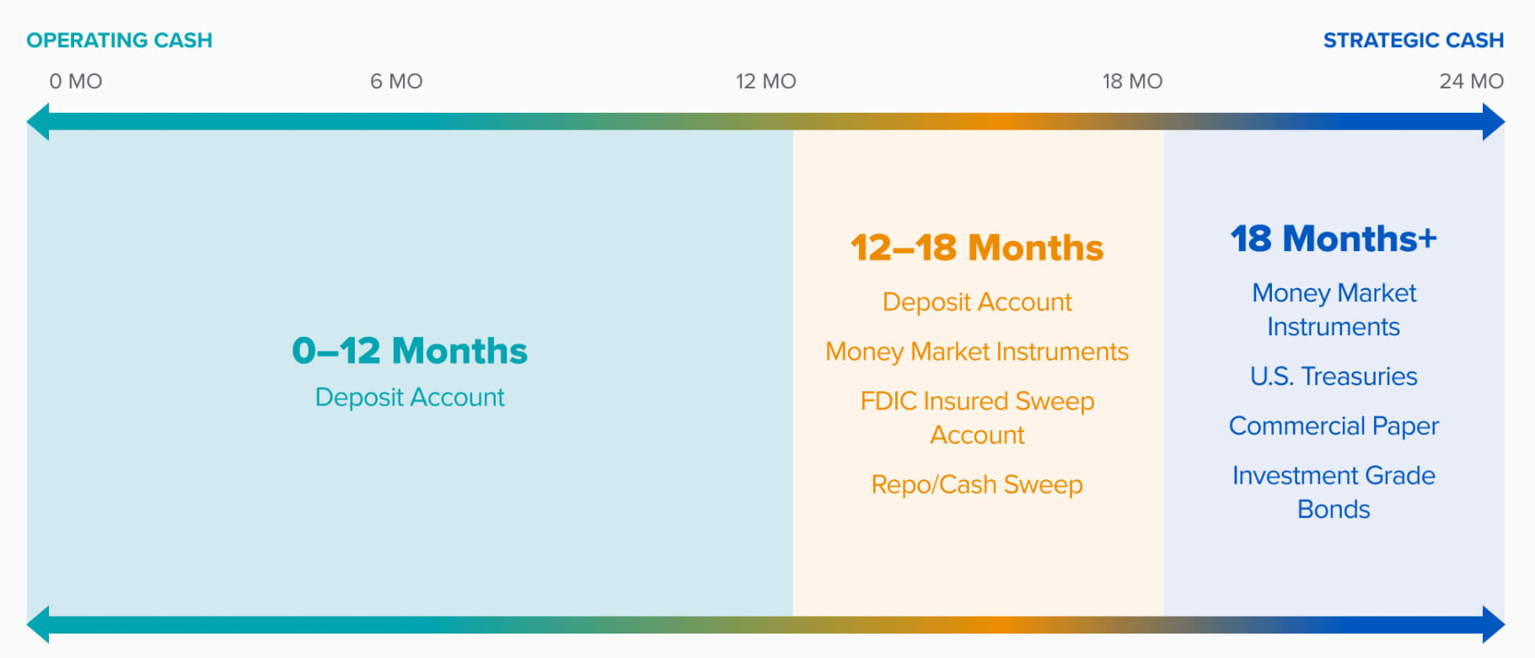
Cash Management

Slide 17
Thank you

